Slide 1




IOT BASED SMART FARMING SYSTEM USING AI
Team Members Name
Varad Agarwal
Shyam Singh
Yuvraj Singh Rathore
Presented By:
Tech Raiders

Slide 2
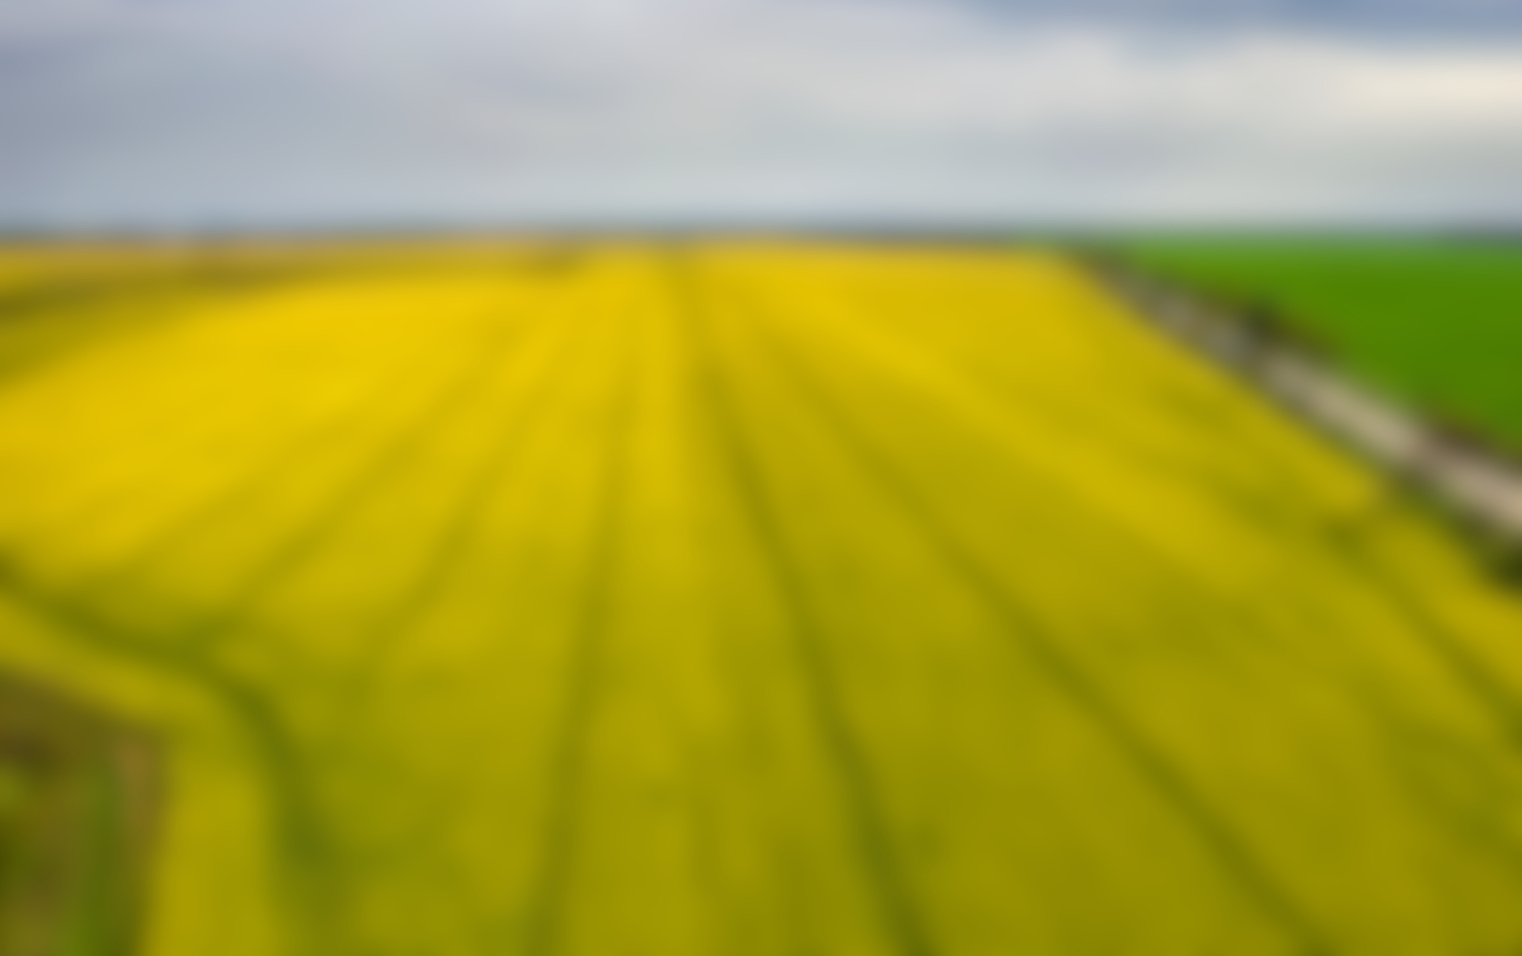
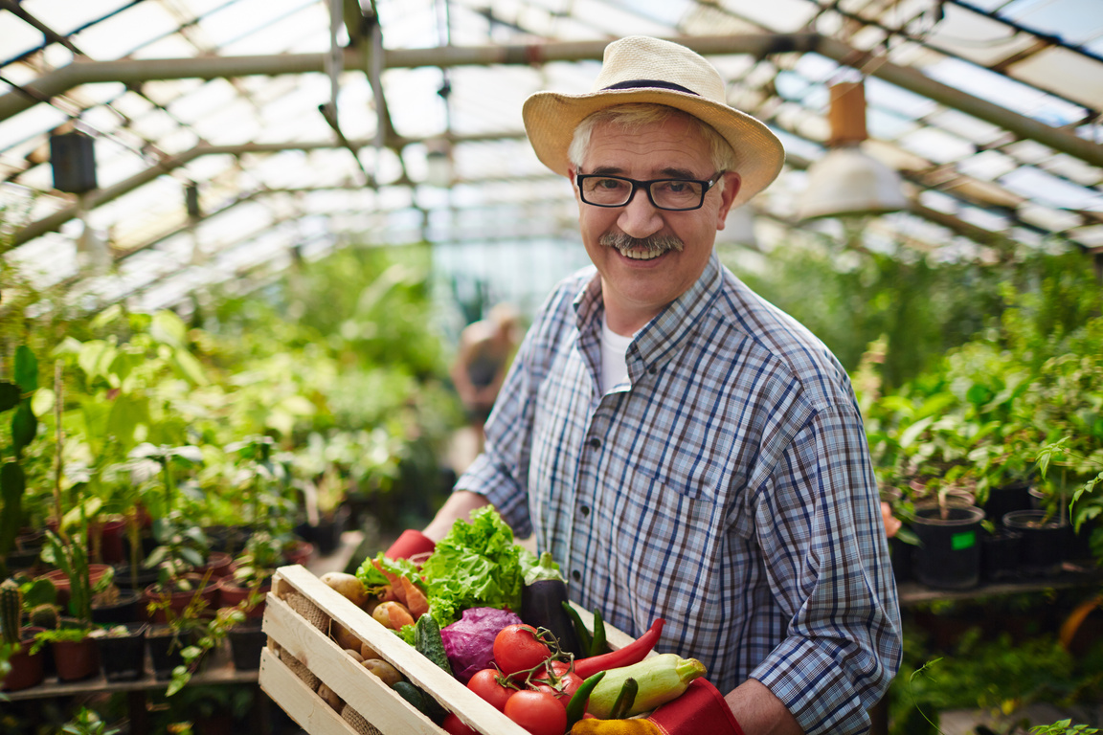
Data Science in Agriculture
Remote Sensing for Field Analysis
Precise Agriculture
Crop Rotation Recommendations
Disease Prediction using CNN
Data-Driven Decision Support
Increase in crop yield
Optimized Resource Allocation

Slide 3

Features of Project
AI-Driven Crop Recommendations: Use machine learning to recommend crops based on soil, climate, and historical data for improved yields and resource management.
Disease Prediction and Prevention: Employ deep learning to detect plant diseases early, reducing crop losses.
IoT Data Collection: Utilize IoT sensors for real-time environmental data, aiding decision-making and remote field monitoring.
Remote Field Activity Control and Management: Utilizing IoT and AI, remote control optimizes farming: adjust irrigation, monitor conditions, and conserve resources for sustainable agriculture.
Drip Irrigation with Auto-Control: Implement manual and automatic control of the drip irrigation system for efficient water management.

Slide 4
IoT in Agriculture
Hardware
Software
NodeMCU ESP8266
Soil Moisture Sensor
DHT11 Sensor
Soil npk Sensor
LDR
Submersible Mini Water Pump
12V LED Strip
7805 Voltage Regulator
2×TIP122 Transistor
Resistor (4.7K, 10K)
Capacitor (0.1µF, 10 µF)
DS18B20 Temperature Sensor
Adafruit IO
Circuito.io
Arduino ide

Slide 5
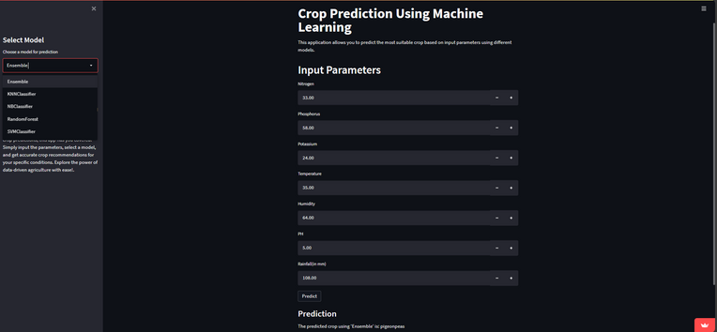
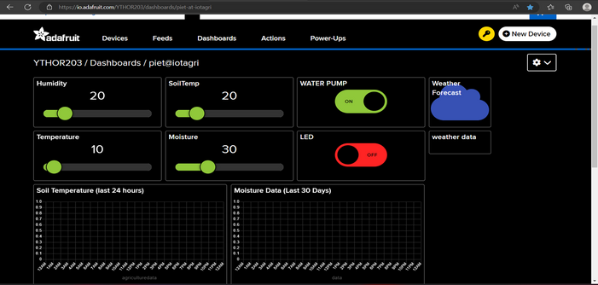
Crop Prediction app(streamlit)
Adafruit IO Dashboard

Slide 6
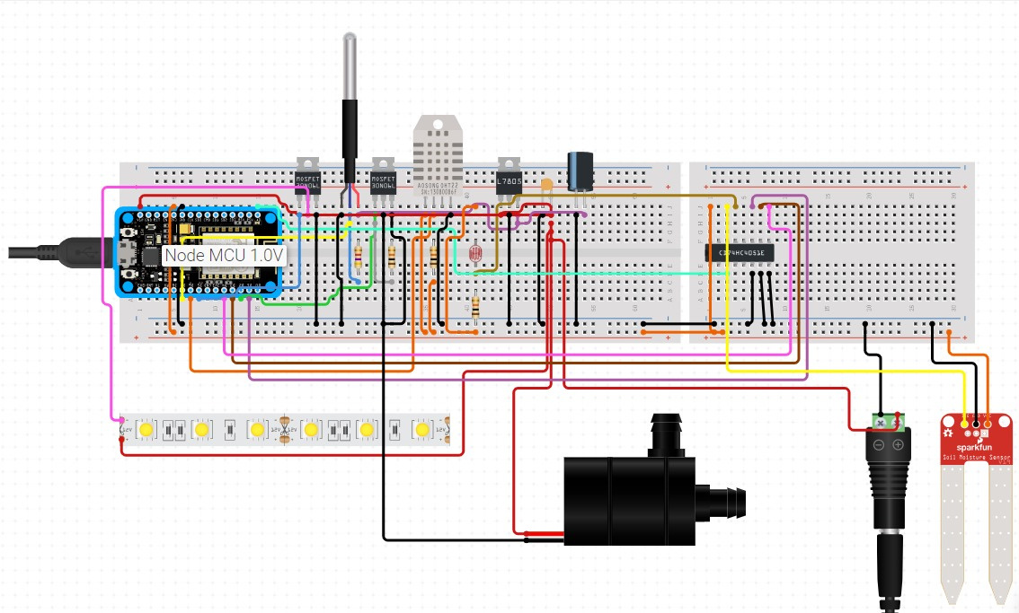
Circuit Diagram

Slide 7
Advantages
Data Collection and Prediction
Remotely Control
Lowered Operation Costs
Increased Quality of Production
Accurate Farm and Field Evaluation
Maximizing yield while minimizing resource utilization
High productivity in less resources
Real-time and intelligent cost management
Crop and Disease prediction to increase yield

Slide 8
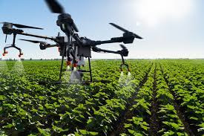
FUTURE SCOPE
Improve User Interface
Hardware implementation
Create User-Friendly App
Medicine & Fertilizer recommendation
Implementation of a language-agnostic platform supporting diverse linguistic interfaces.
Improve User Interface
Build App
Fertiliser quantity predict
Display content in Multiple Language

Slide 9
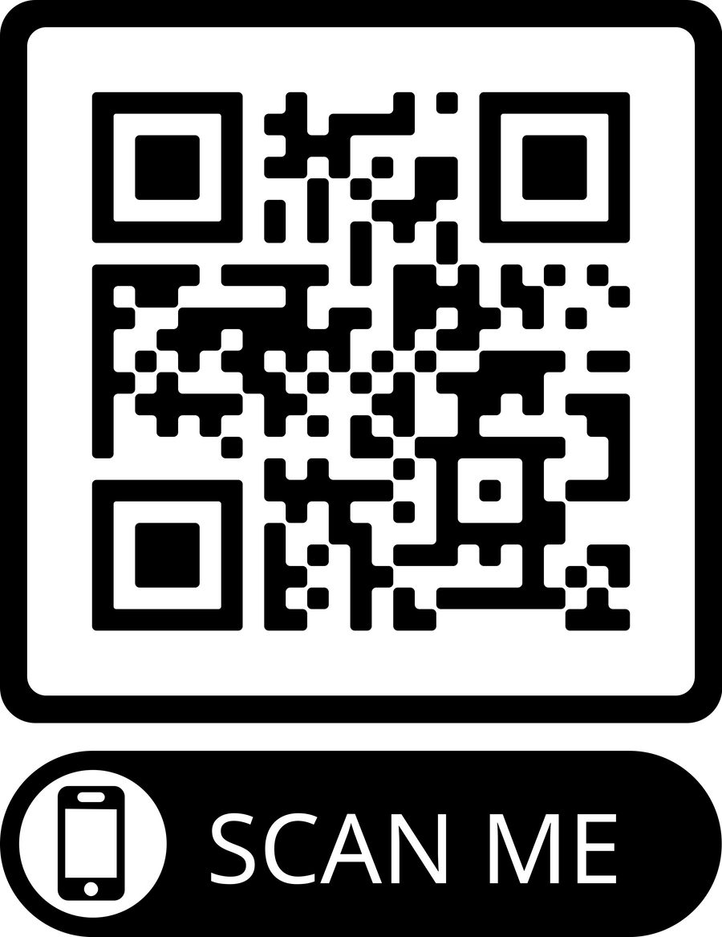
Scan for predict crop

Slide 10
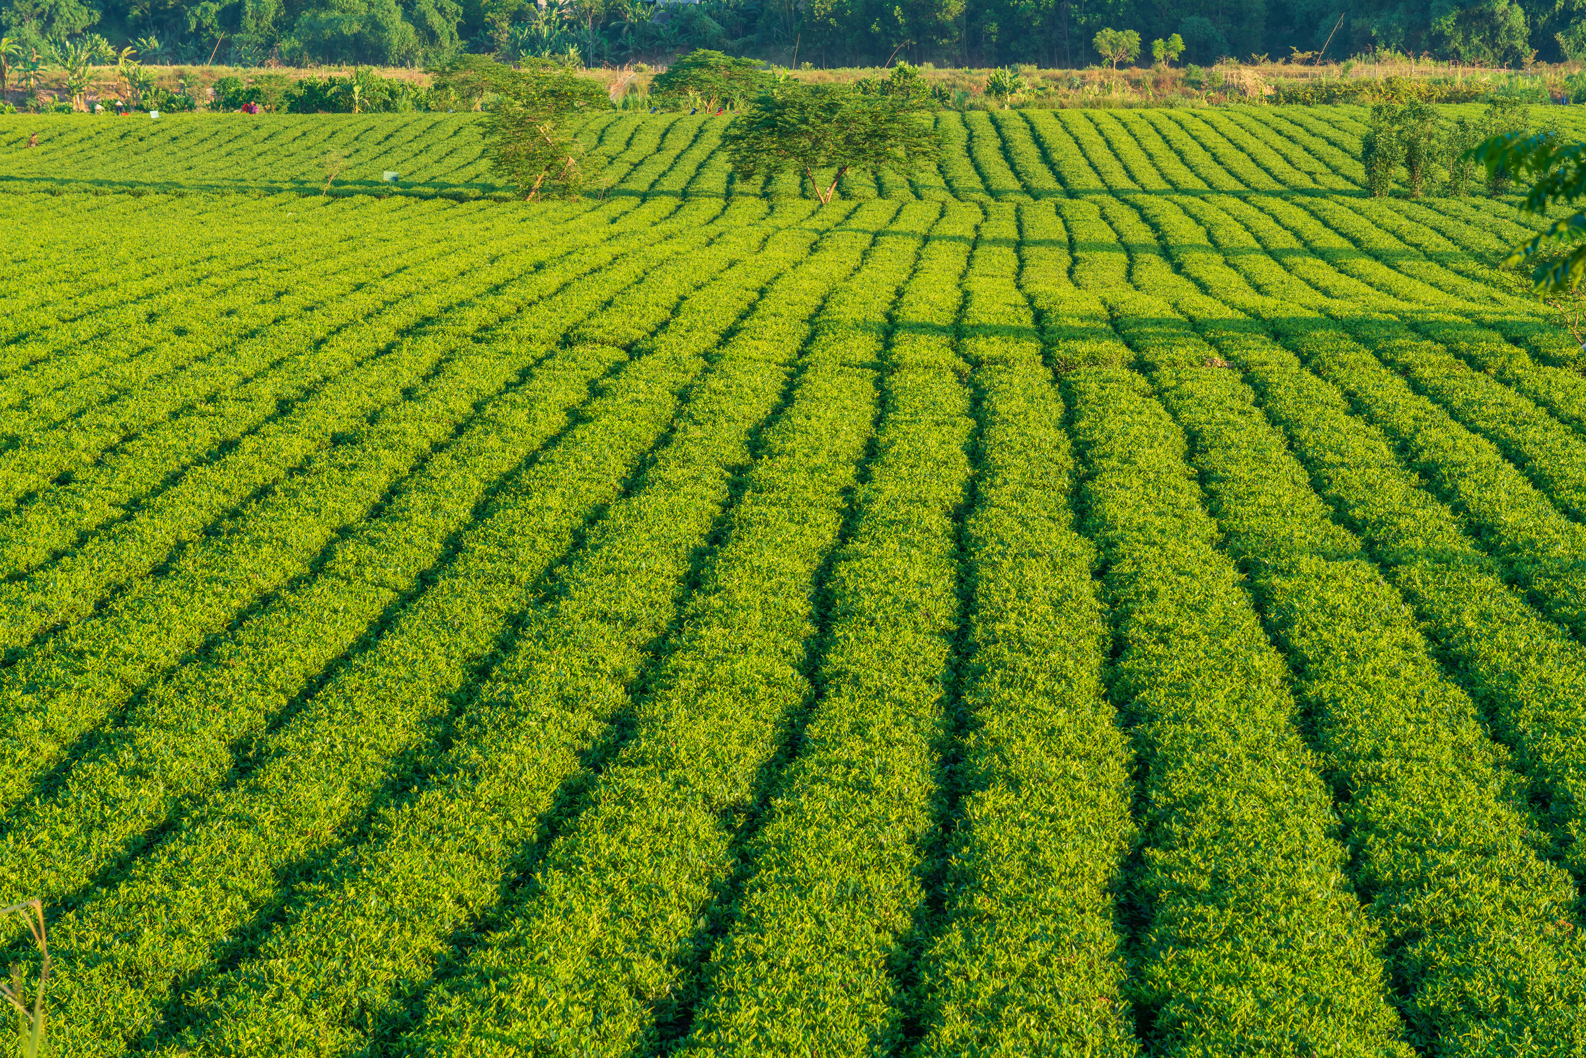
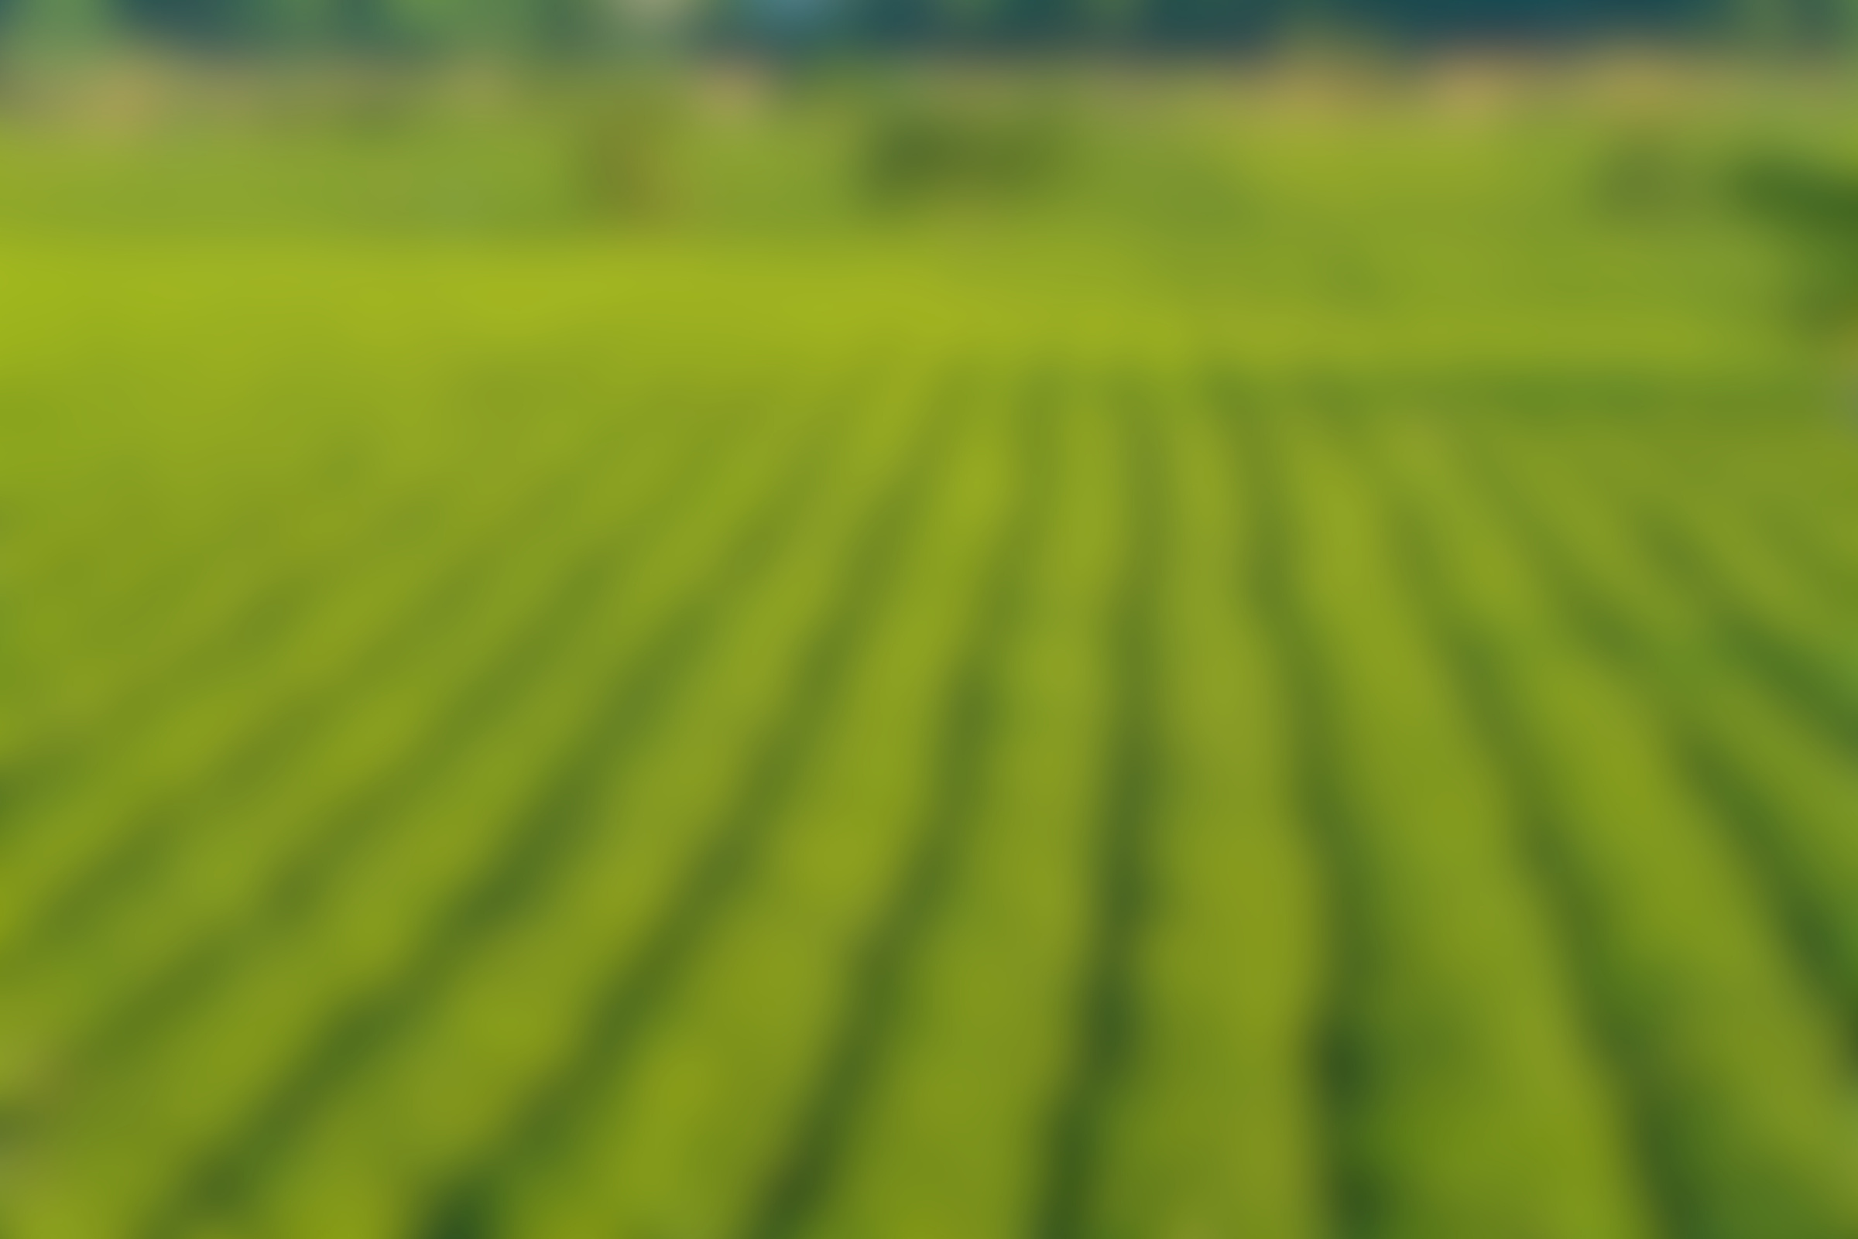
THANKS

